Slide 1

MATLAB-Based Recommender System for Personalized Medicine (DISEASE PREDICTOR)
Presented by: MANJUNATH V-20
Dayananda Sagar University | Date: 24-05-2025

Slide 2

Introduction to Personalized Medicine
Definition
Importance
Treatment customized to individual patient data
Improves efficacy by targeting specific patient needs
Role of Recommender Systems
Assist clinicians with personalized treatment options

Slide 3

Problem Statement
Generalized Treatments
One-Size-Fits-All Limitations
Often ineffective for complex diseases
Fails to address individual variability
Need
System to suggest treatments based on patient profiles

Slide 4
Project Objectives
Development
Input
Output
Goal
Recommender system built using MATLAB
Patient data: symptoms, medical history, genetics
Personalized treatment suggestions
Improve efficacy and patient outcomes

Slide 5
Methodology Overview
Data Collection
Preprocessing
Feature Selection
Model Building
Implemented in MATLAB
Evaluation

Slide 6
Dataset Details
Source
Features
Labels
Public medical datasets or synthetic data
Symptoms and disease labels
Recommended drugs or therapies based on symptoms

Slide 7
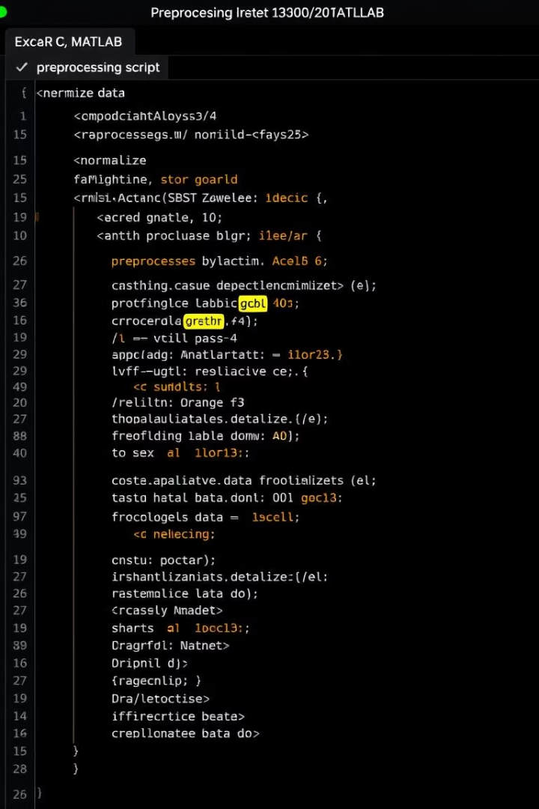
MATLAB Implementation
Preprocessing
Symptom Matching
Normalization, handling missing values
Scores diseases by matching symptoms aggregation
Disease Prediction
Selects disease with highest aggregate score

Slide 8
System Architecture
Input Layer
Processing Layer
Output Layer
Diseases, symptoms, severity, precaution, medication, diet, workout
ML algorithms implemented in MATLAB
Recommended treatments and lifestyle plans

Slide 9
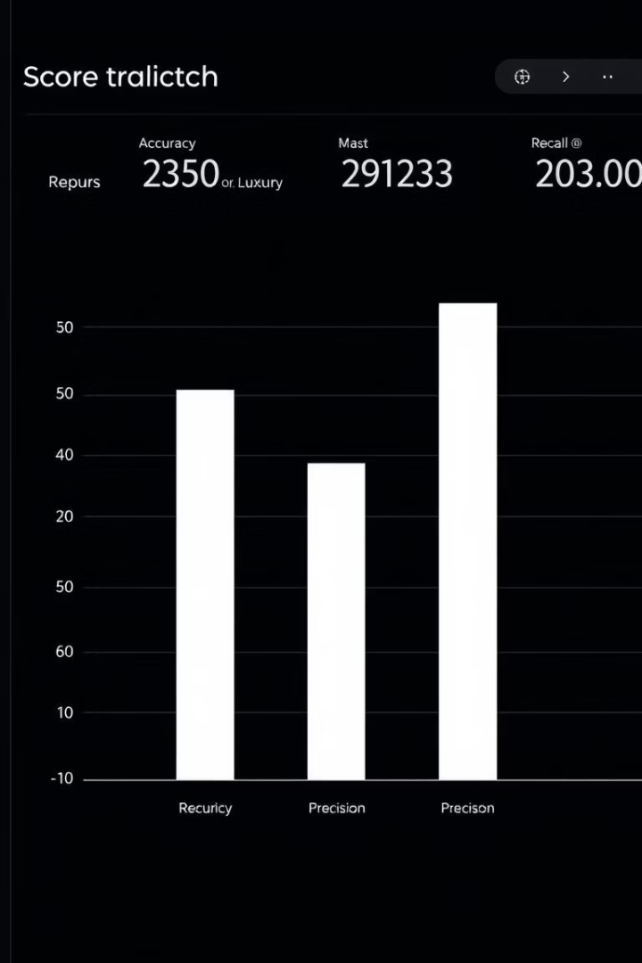
Results and Evaluation
Accuracy
Precision & Recall
Measures correct disease predictions
Assess true positive rates for treatments
Recommendations
Precautions, medications, diet, workouts suggested

Slide 10

Advantages of the Recommender System
Tailored Treatments
Reduced Trial and Error
Faster Recovery
Customized based on individual profiles
Minimizes ineffective medication attempts
Lower side effects, better outcomes

